Slide 1
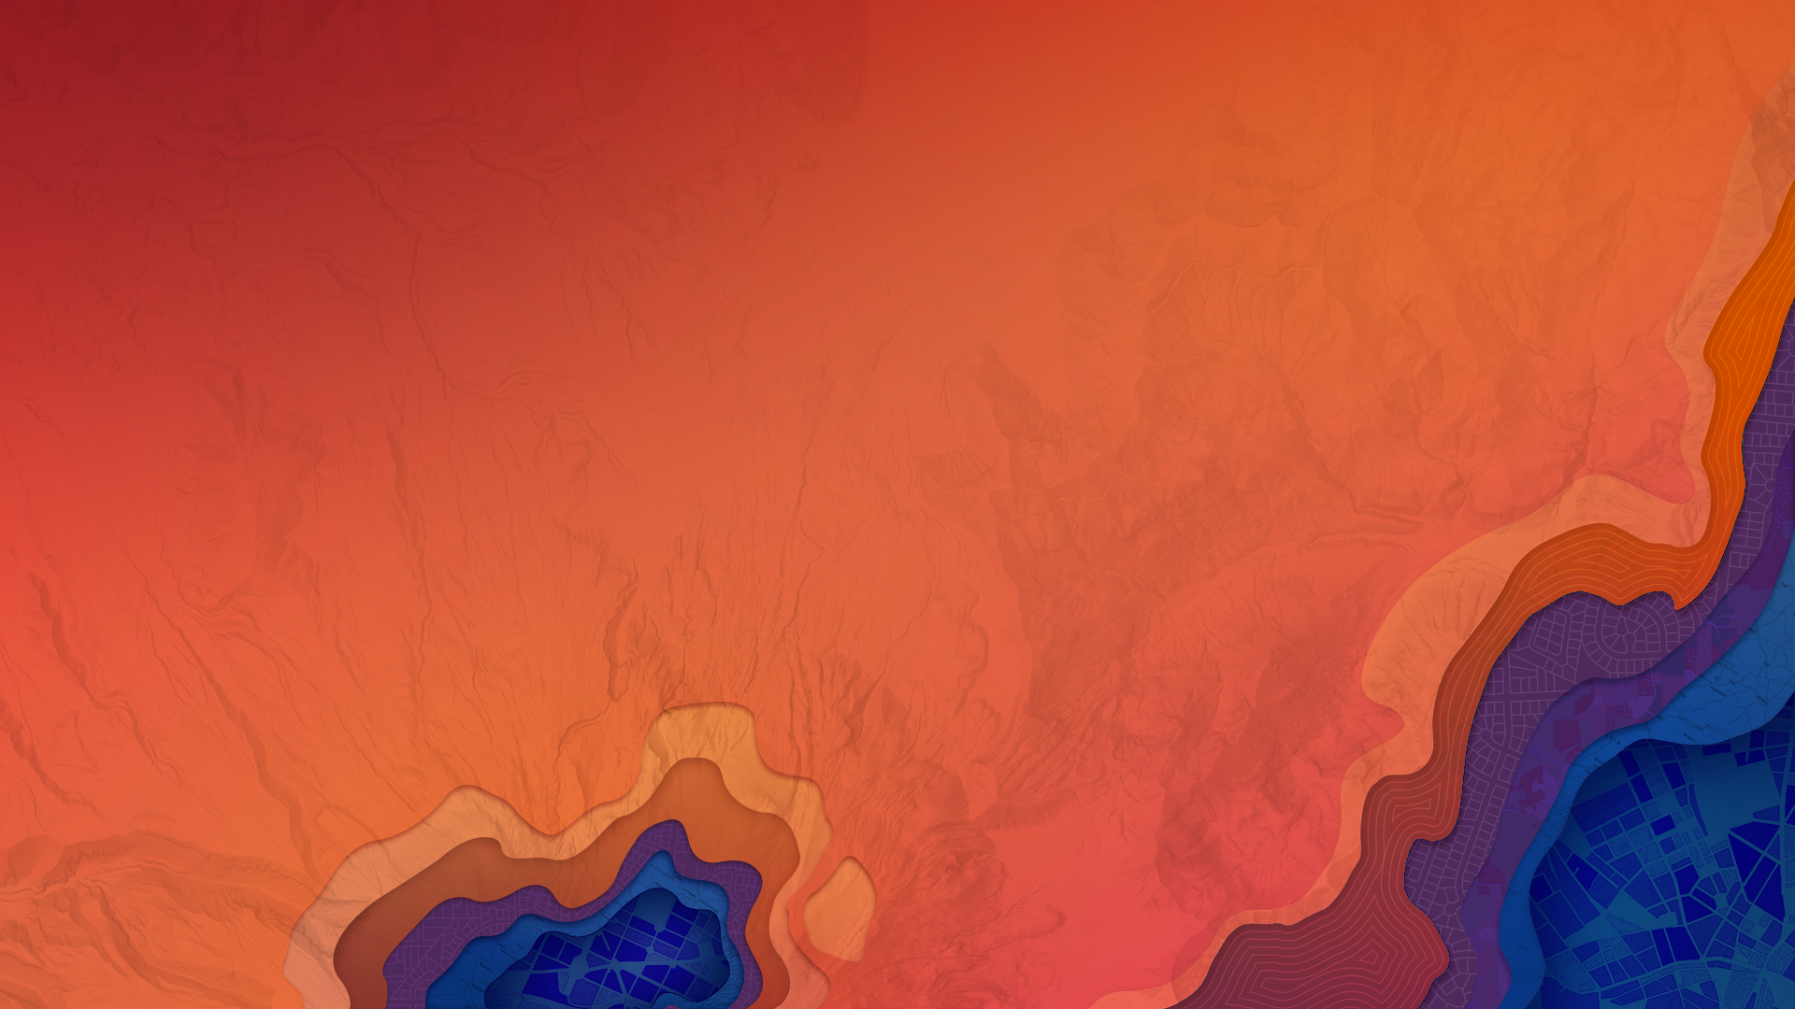


2D Visualization with the ArcGIS API for JavaScript
Kristian Ekenes
Praveen Ponnusamy

Slide 2
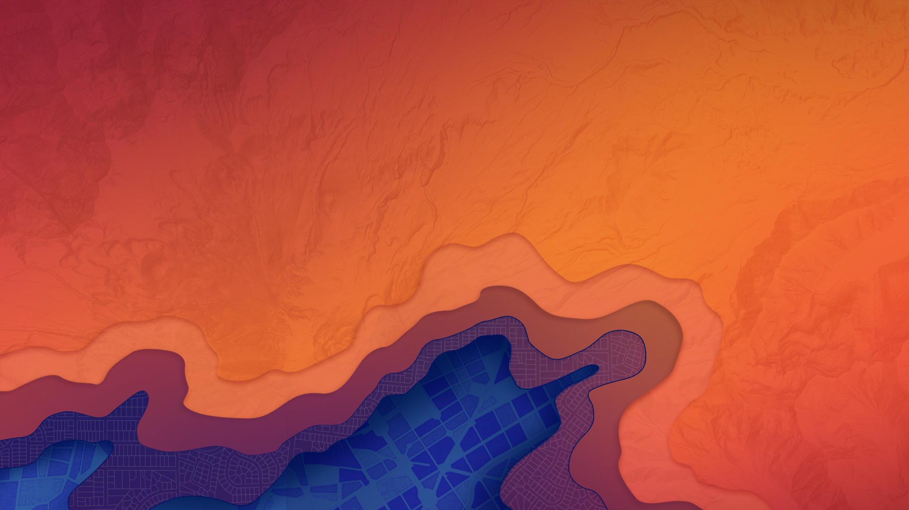
API Overview
Renderers, symbols, etc…

Slide 3

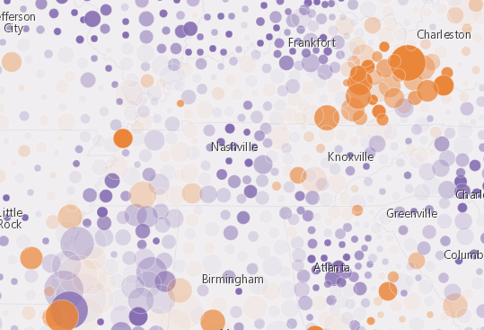
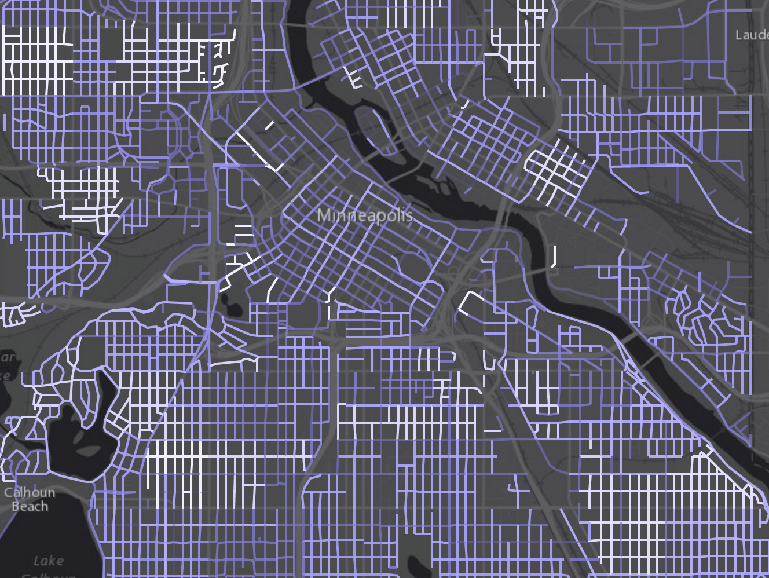
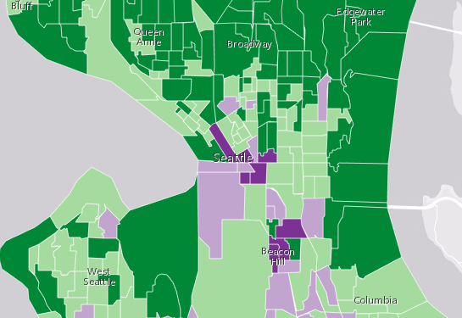
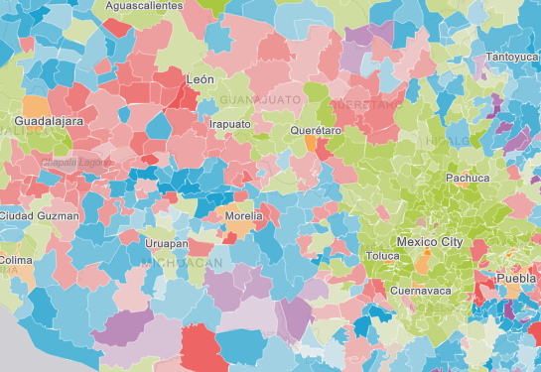
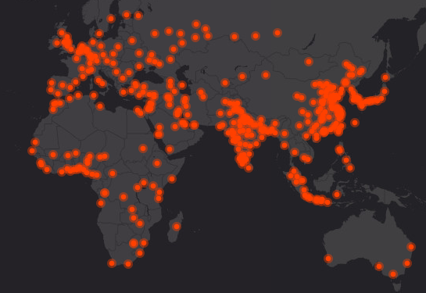
What can we visualize?
Where?
What?
How much?
When?
Combinations of the above

Slide 4
Data
FeatureLayer
MapImageLayer
CSVLayer
StreamLayer

Slide 5
Symbols

Slide 6
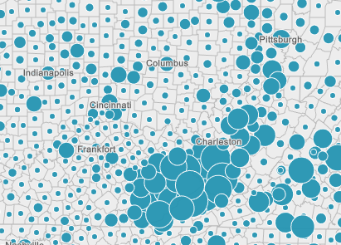
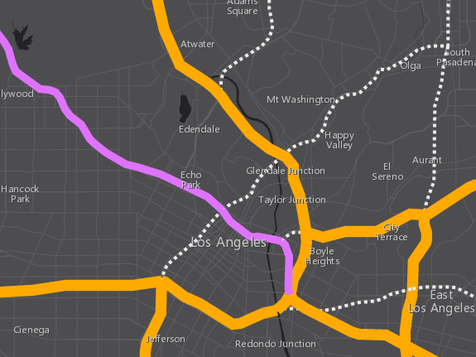
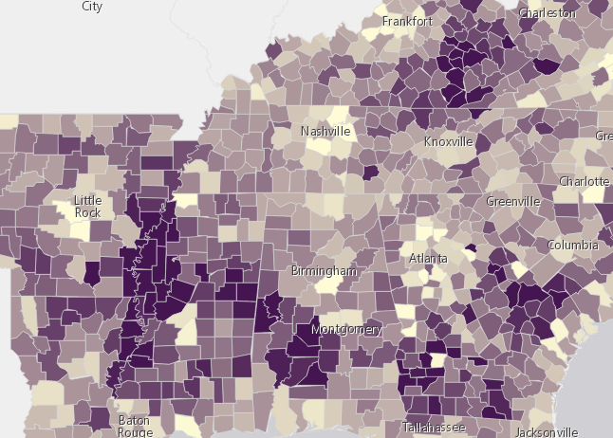
Symbols
based on geometry type
Points
Lines
Polygons
SimpleMarkerSymbol
SimpleFillSymbol
SimpleLineSymbol
PictureMarkerSymbol
PictureFillSymbol

Slide 7
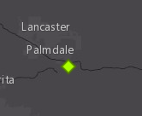
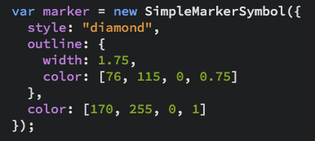
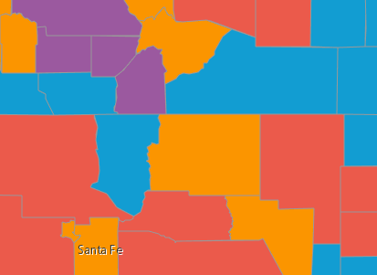
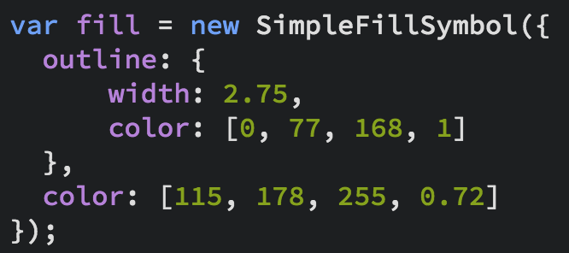
Symbols

Slide 8
Data-driven visualization
Field value(s)
TOTAL_POP
Arcade expression
Round( ($feature.BACHELOR + $feature.MASTER) / $feature.POP_25UP) );
JavaScript function
function (graphic){
return graphic.attributes.POP_DENSITY;
}

Slide 9
Renderers

Slide 10
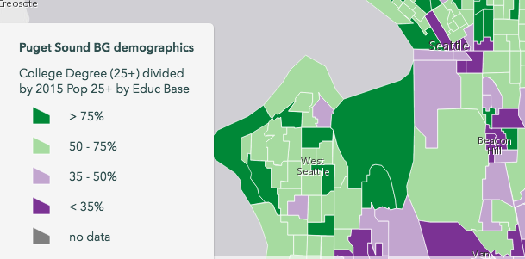
UniqueValueRenderer
Renderers
SimpleRenderer
ClassBreaksRenderer

Slide 11
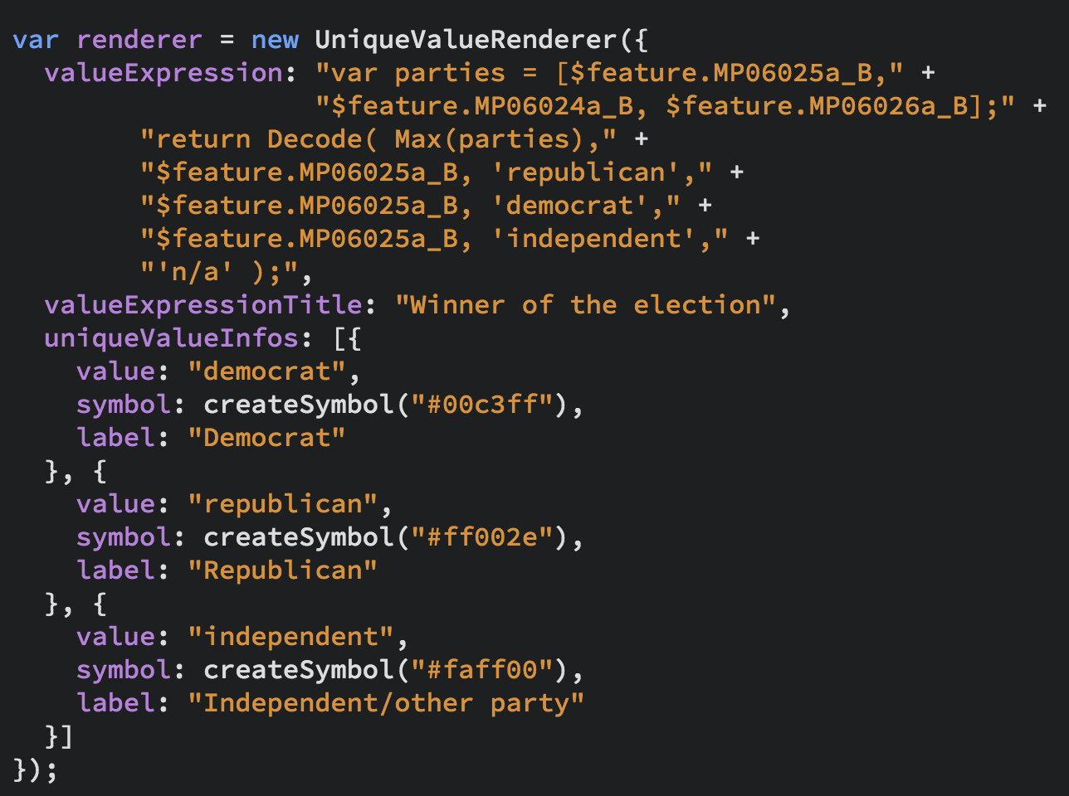
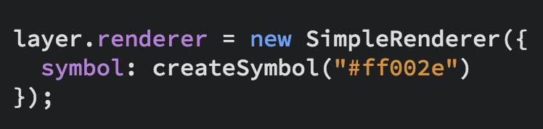
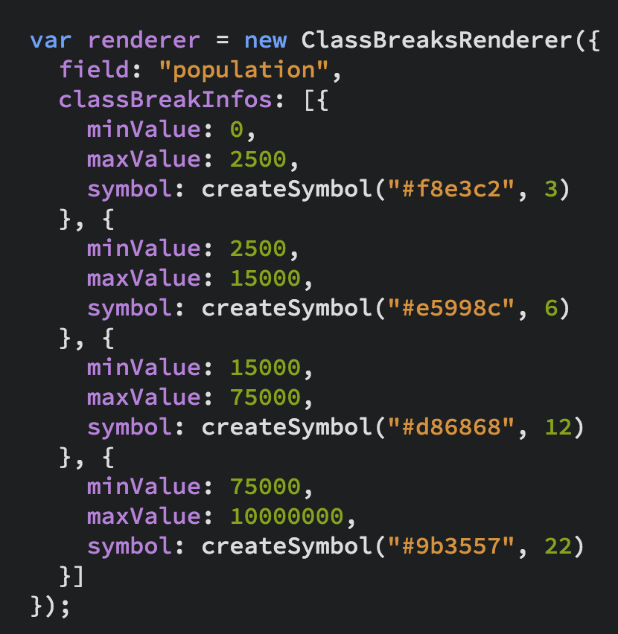
UniqueValueRenderer
Renderers
SimpleRenderer
ClassBreaksRenderer

Slide 12
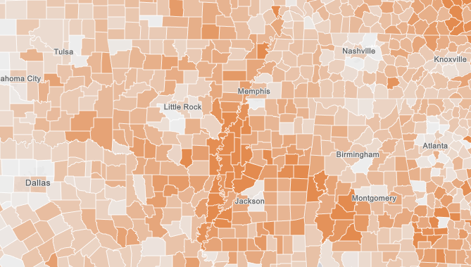
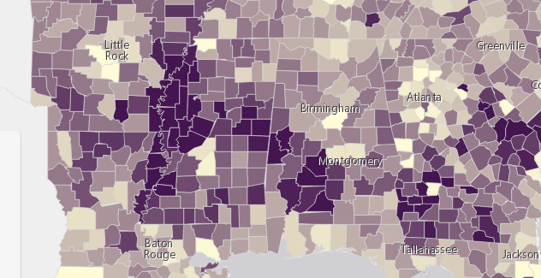
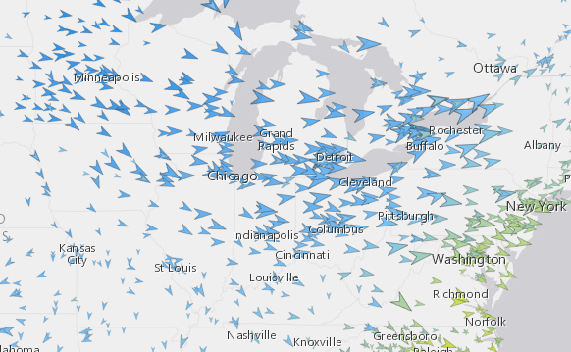
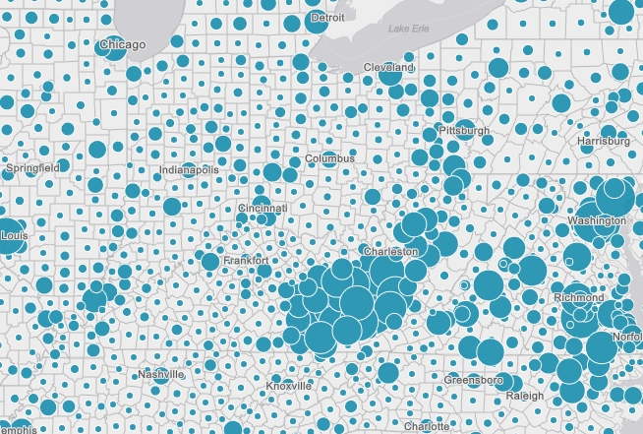
Renderers
Visual Variables
A property of the renderer
For numeric data-driven continuous visualizations
Color
Size
Opacity
Rotation

Slide 13
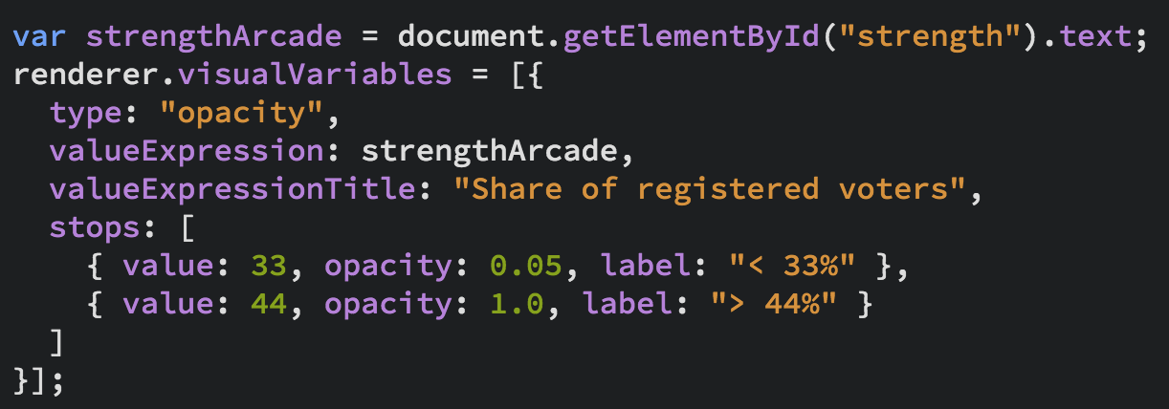
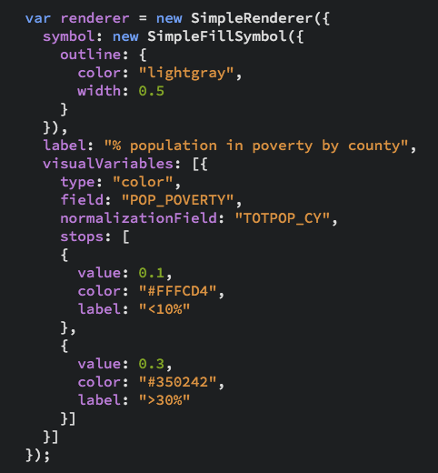
Renderers
Visual Variables

Slide 14
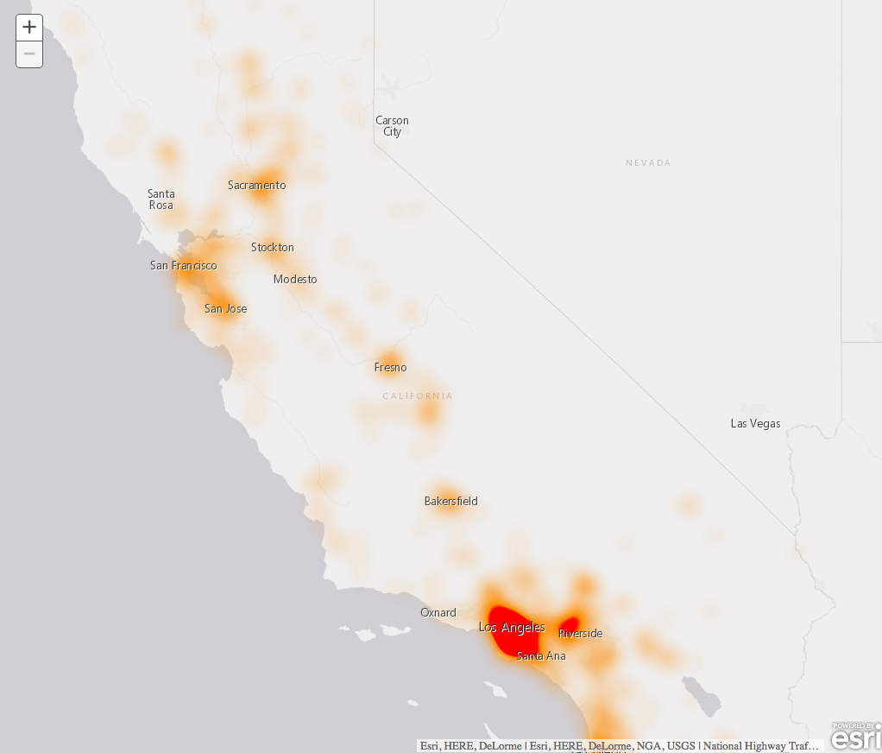
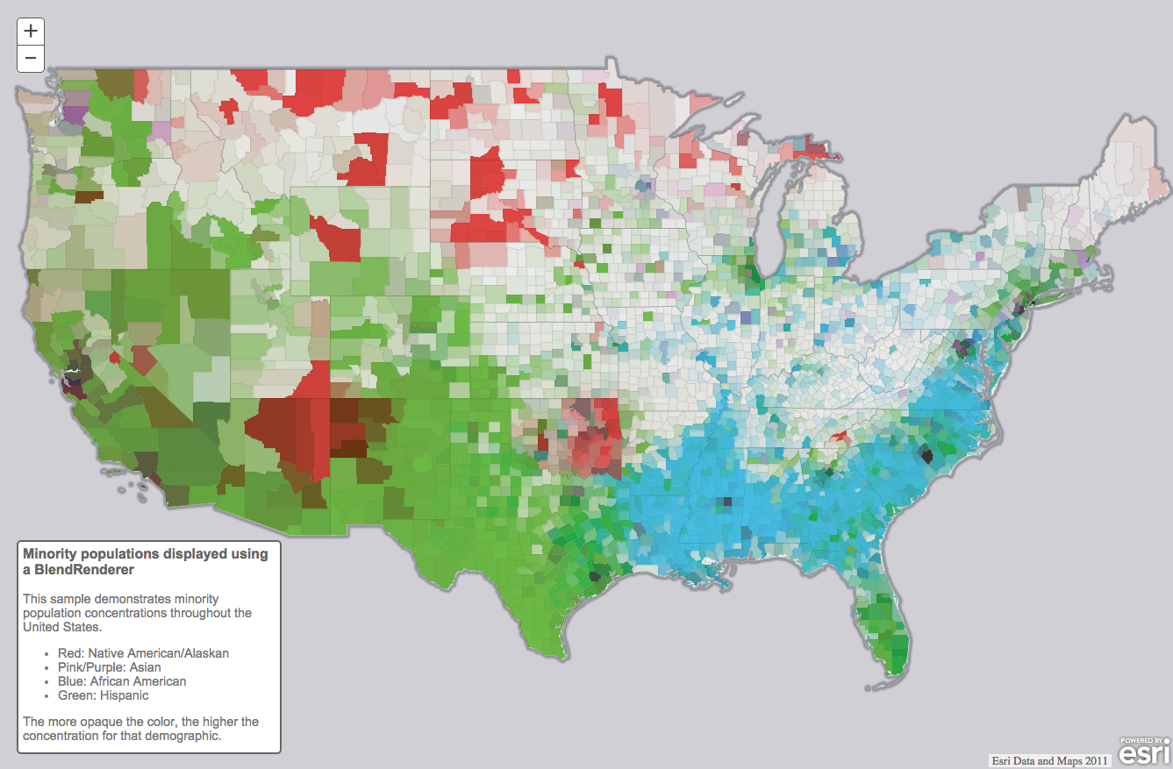
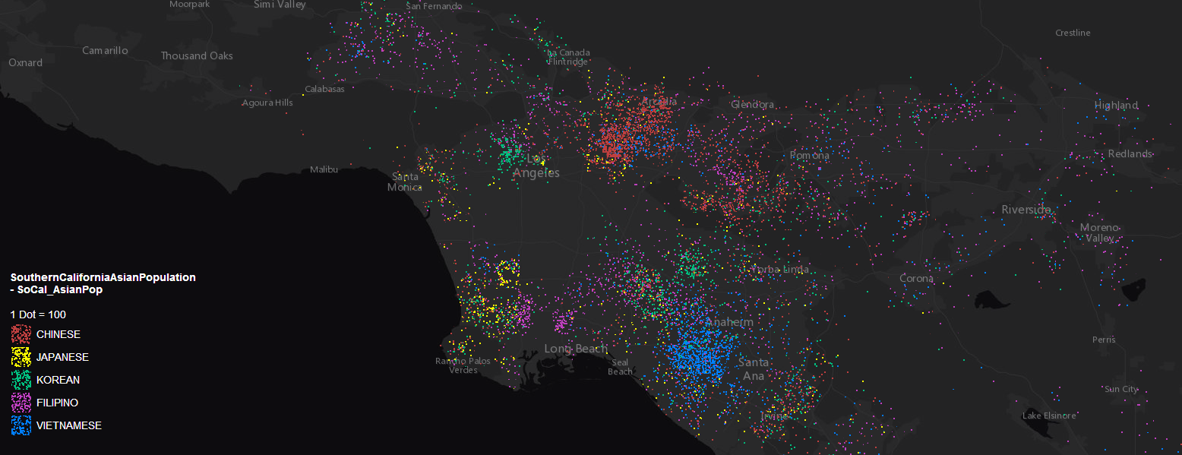
Renderers (3.x only)
HeatmapRenderer
BlendRenderer
DotDensityRenderer

Slide 15
Examples

Slide 16

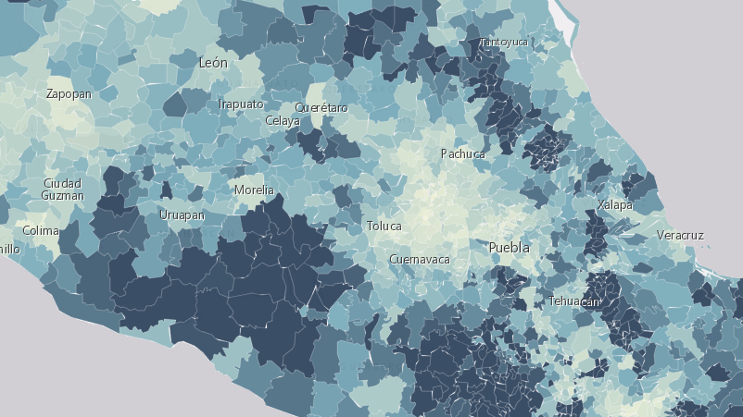
Visual variables

Slide 17
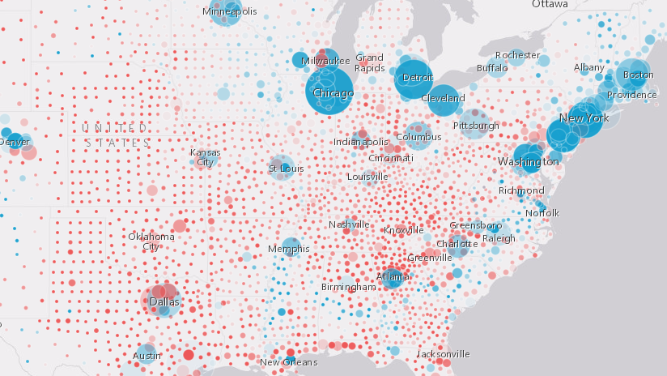
Multivariate visualizations

Slide 18
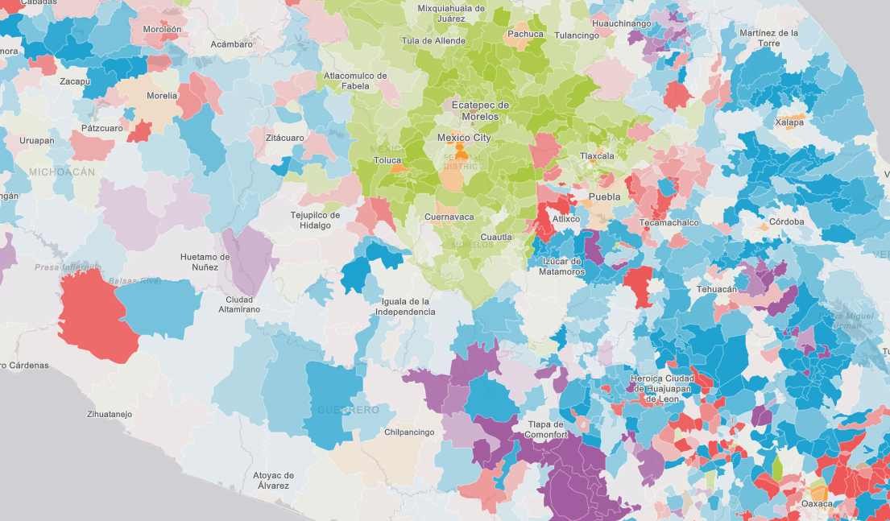
Predominance using Arcade

Slide 19
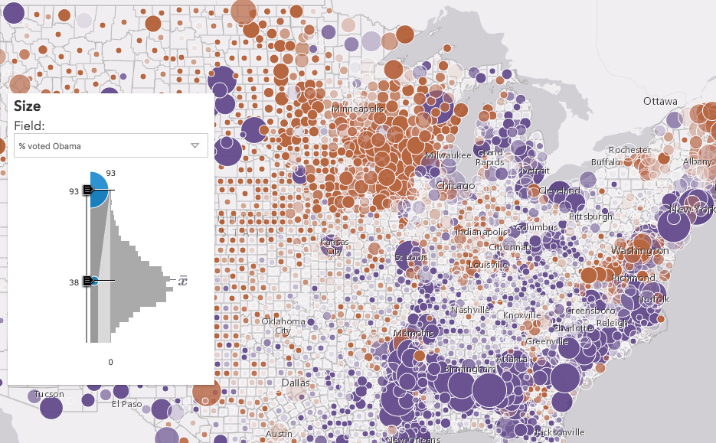
Data exploration
Smart mapping in custom apps

Slide 20
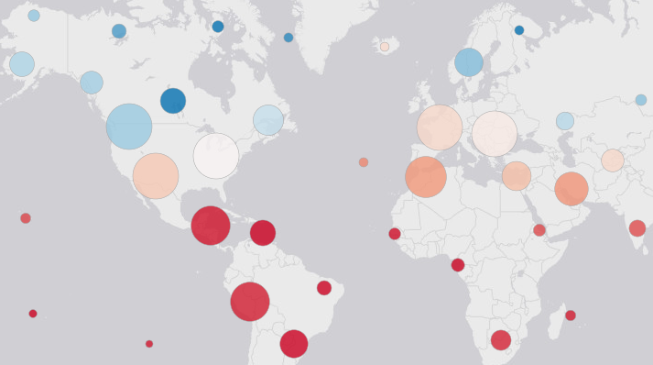
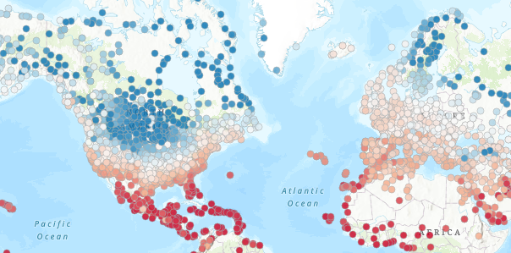
Clustering
Coming in a future release

Slide 21
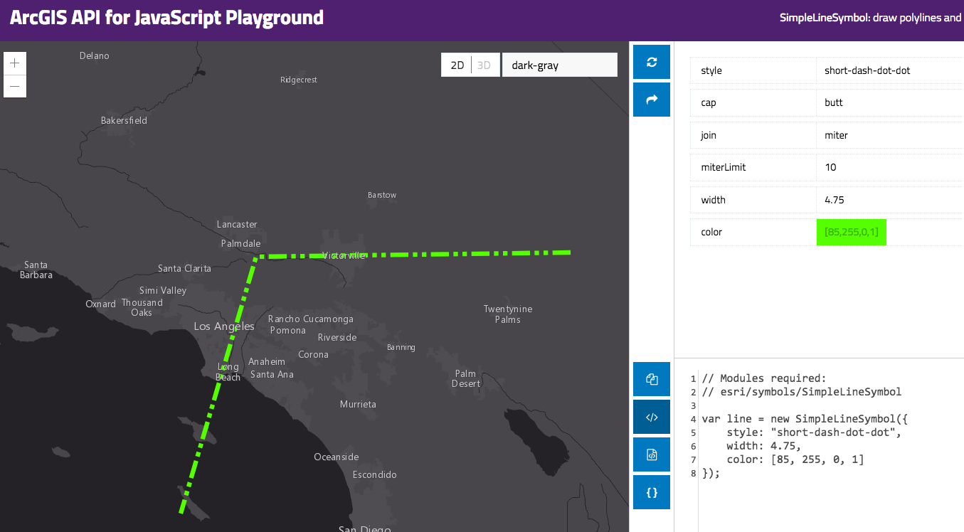
Resources
Get started with visualization
ArcGIS Blog
Visualizing data in web apps
Predominance visualizations using Arcade
Using Arcade expressions in web apps
Documentation
Renderer
Symbol

Slide 22



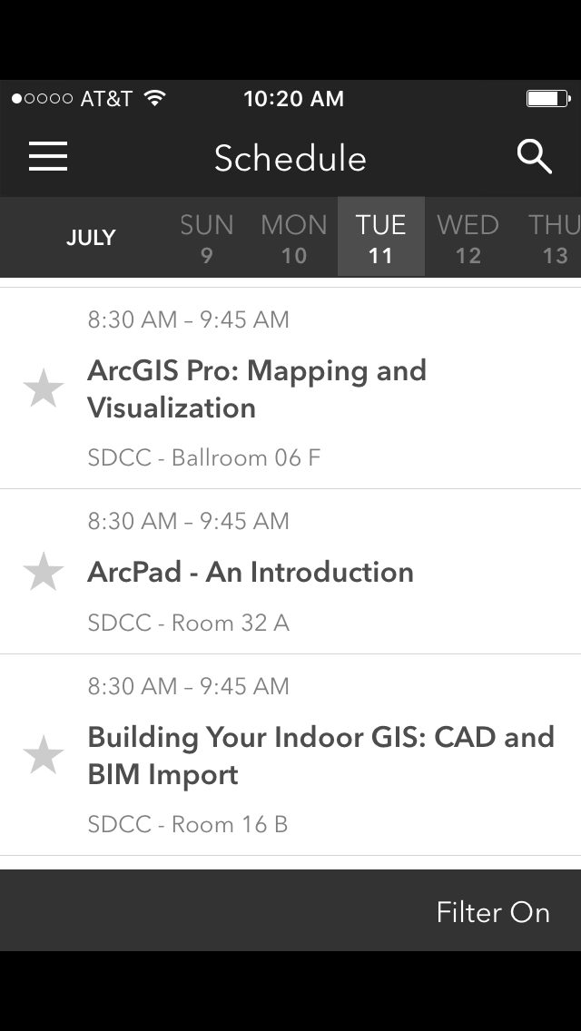
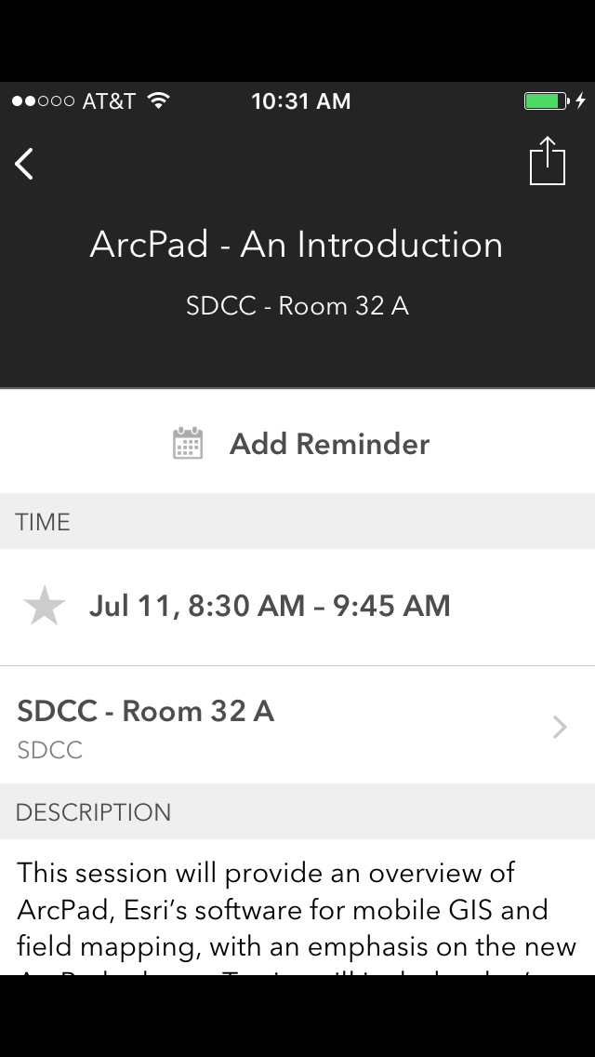
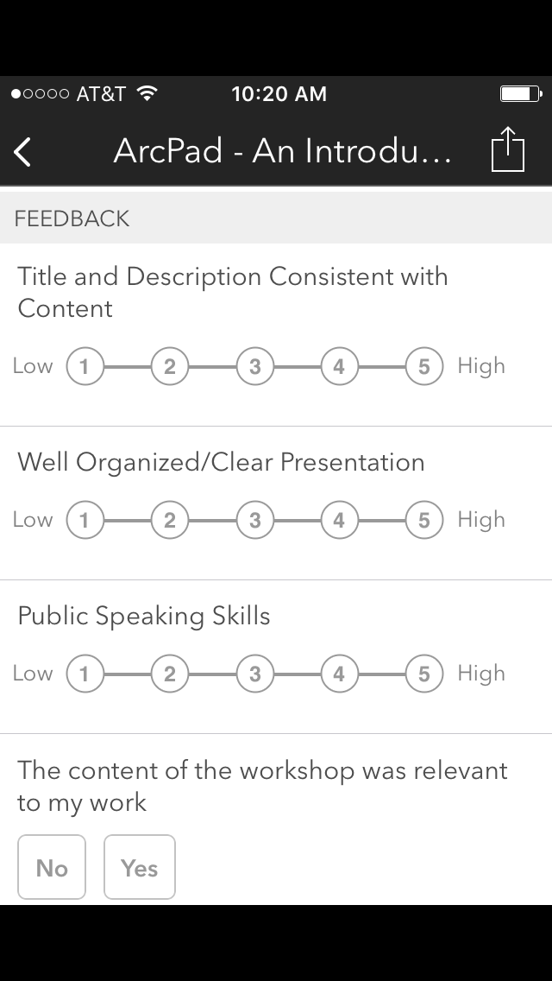

Please Take Our Survey on the Esri Events App!
Download the Esri Events app and find your event
Select the session you attended
Scroll down to find the survey
Complete Answers
and Select “Submit”

Slide 23



